Slide 1

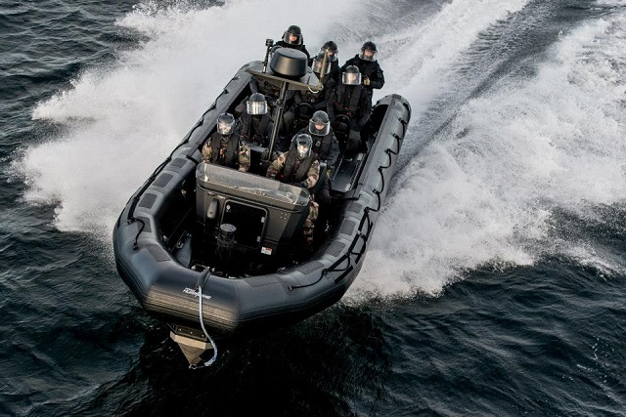
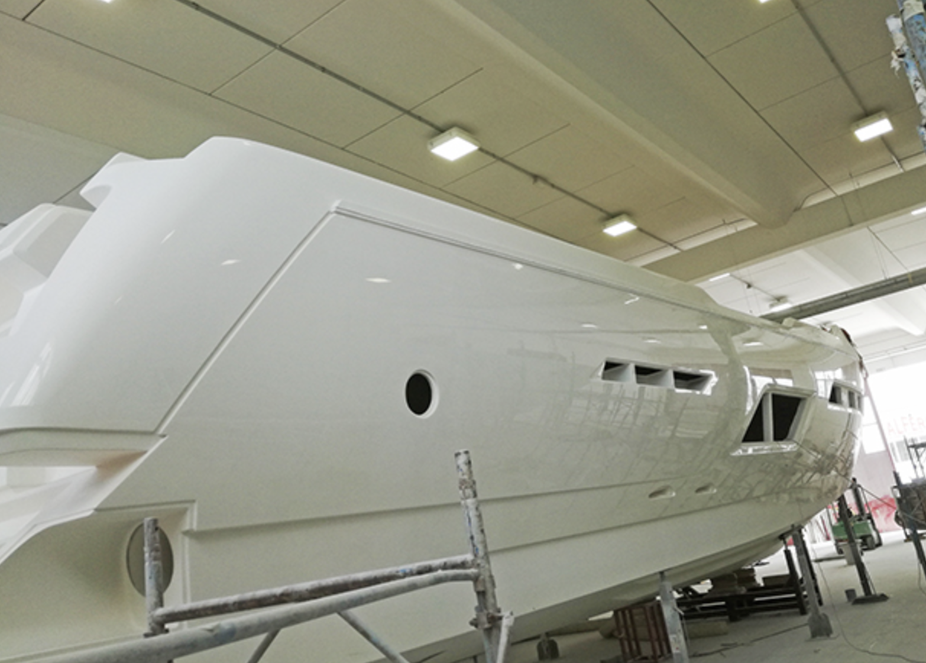

ADVANCED COMPOSITES CONSTRUCTIONS
Advanced Solutions for Naval Forces
We build the future of naval defense through next-generation composite technology.

Slide 2

Modern Naval Challenges
Contemporary naval forces face increasingly complex, dynamic threats. Modern missions demand a precise blend of maximum speed, superior maneuverability, advanced stealth capabilities, and exceptional resilience in extreme operating conditions.
Limitations of Traditional Materials
Steel and aluminum add excessive weight, are vulnerable to corrosion in marine environments, and increase detectability. These conventional materials no longer meet modern operational requirements.
The ACC Solution:
Advanced composite materials that revolutionize military shipbuilding. Our technology delivers superior performance, exceptional durability, and decisive tactical advantages on the naval battlefield.
In today’s geopolitical climate, investing in composite technologies is not merely a strategic choice—it is an operational necessity for maintaining naval supremacy.

Slide 3
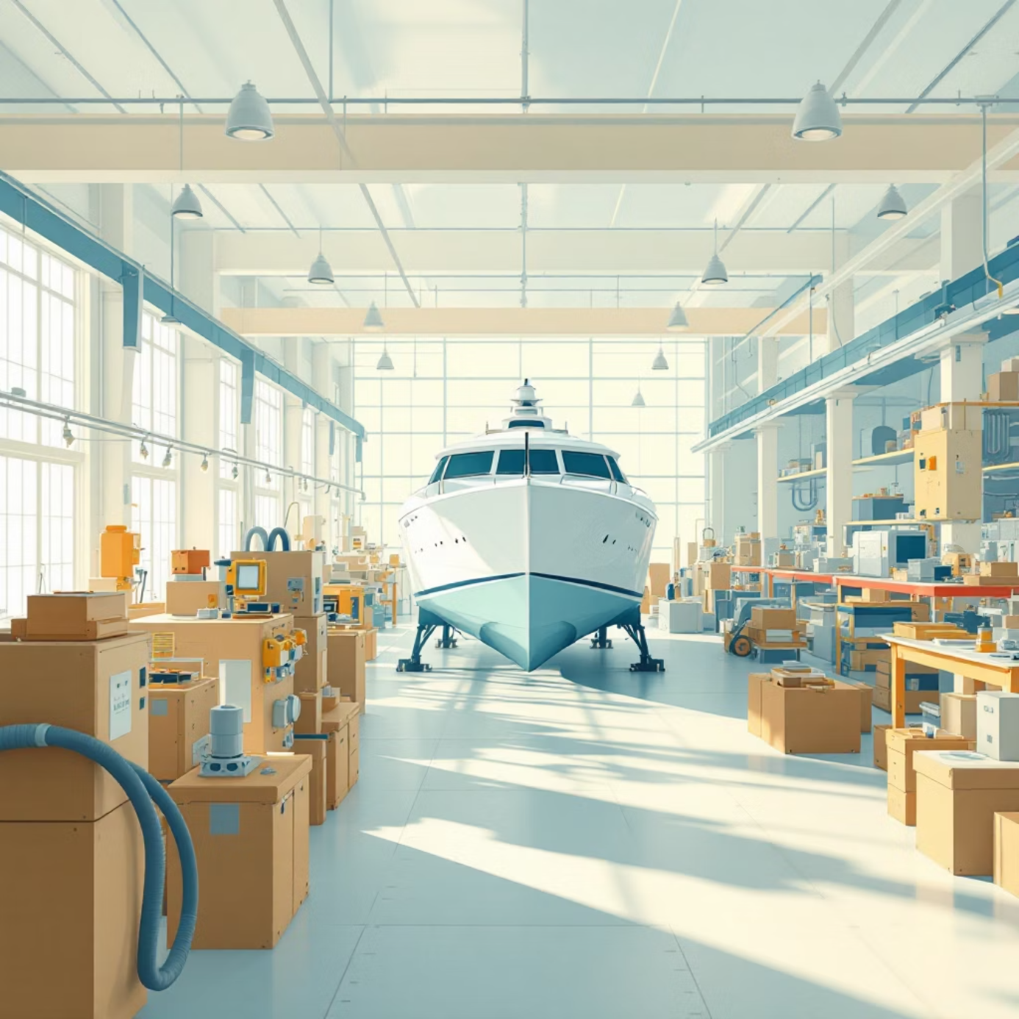
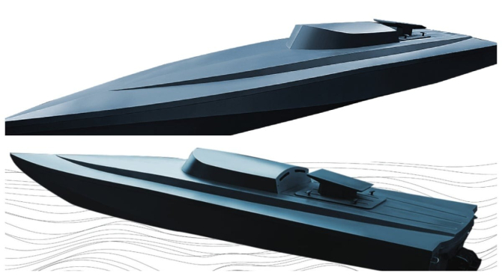
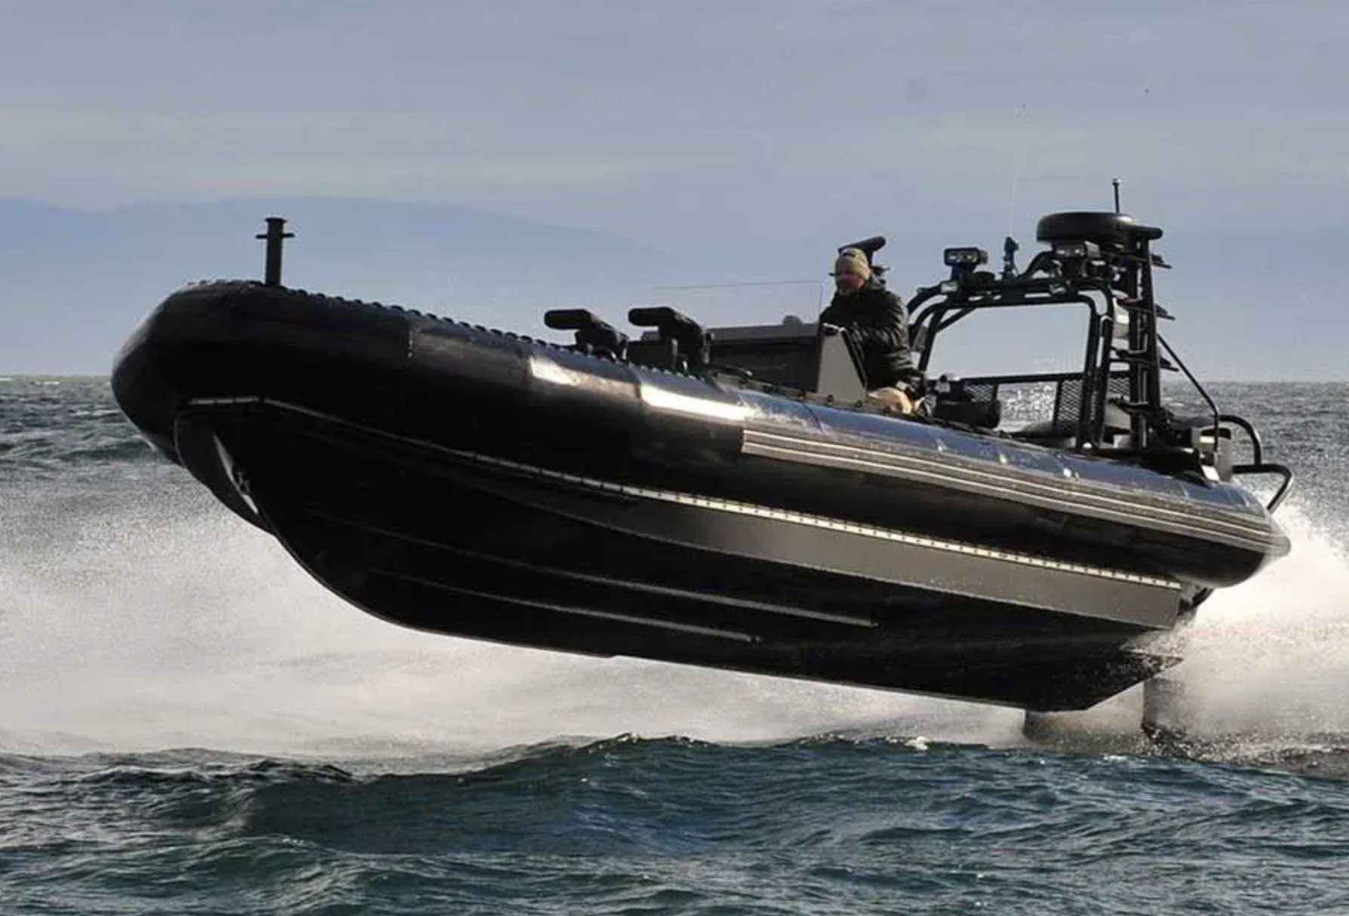
ADVANCED COMPOSITES CONSTRUCTIONS SRL: Expertise and Innovation
Headquartered in Orăștie, Romania, ACC SRL embodies excellence in building vessels from advanced composite materials. Our strategic location ensures privileged access to premium resources and a highly skilled workforce.
We combine Romanian craftsmanship with cutting-edge international technology, delivering tailored solutions for the most demanding military requirements.
Extensive Experience
Commitment to Quality
Years of experience designing and building high-performance composite vessels. Our portfolio includes complex civil and military projects.
Every vessel is built to the strictest international standards. Our quality-control processes guarantee consistent performance and maximum reliability.
Continuous Innovation
Customer Satisfaction
We invest continually in research and development to stay at the forefront of composite technologies. We collaborate with research institutes and industrial partners to deliver cutting-edge solutions.
Long-term relationships with our clients are rooted in trust, transparency, and on-time delivery. We provide comprehensive technical support throughout each product’s lifecycle.
Visit yachtconstructions.com for more information about our production capabilities and completed projects.

Slide 4




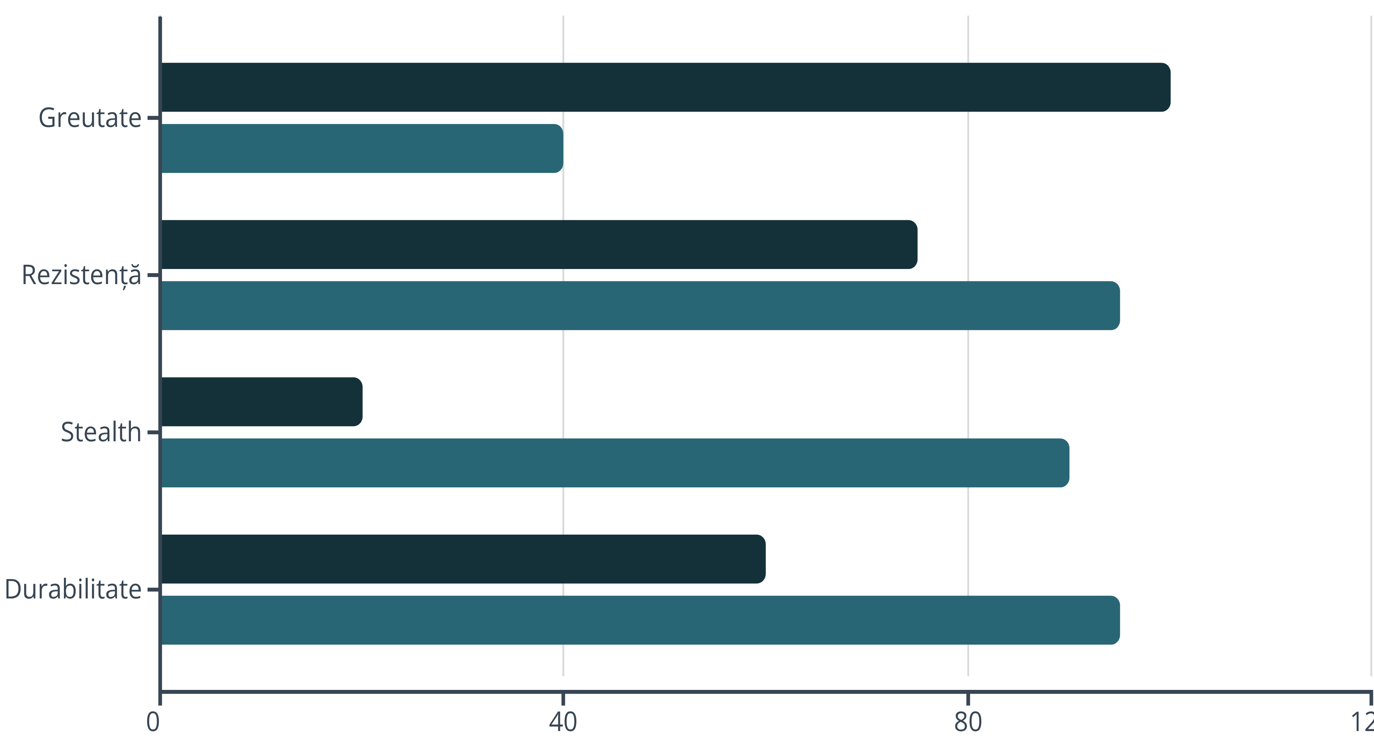
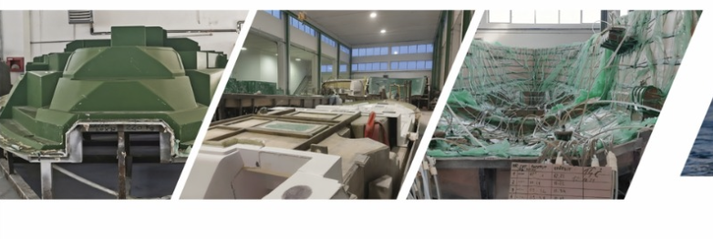


Composite Materials: Key Advantages for Military Applications
The advanced composites used by ACC SRL deliver decisive advantages over traditional steel or aluminum structures, fundamentally transforming the operational capabilities of modern naval fleets.
Significantly Reduced Weight
Superior Multidimensional Strength
Up to 60% lighter than metallic equivalents, directly translating into higher speed, outstanding maneuverability, extended range, and dramatically lower fuel consumption—major long-term operational savings.
Exceptional impact performance, total resistance to corrosion in saline marine environments, and superior fatigue resistance. Our composites maintain structural integrity even in the harshest operating conditions.
Advanced Stealth Capabilities
Long-Term Durability and Economy
Dramatically reduced radar signature, virtually eliminated magnetic signature, and minimized infrared footprint. These characteristics deliver a decisive tactical advantage in special operations and sensitive missions.
Maintenance costs reduced by up to 70% compared with metal structures. Extended service life without significant degradation results in a dramatically lower total cost of ownership.
Steel
ACC Composite

Slide 5








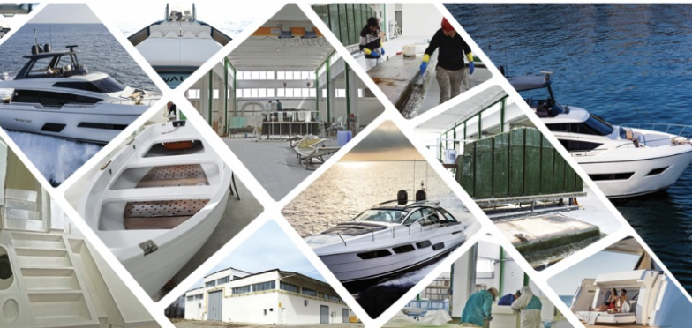
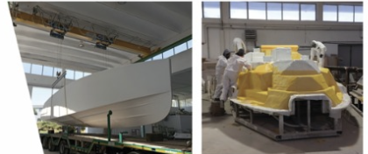

Military Applications: ADVANCED COMPOSITES CONSTRUCTIONS Solutions
Our military solutions portfolio covers the full spectrum of modern naval operational needs. Every platform is engineered and built to deliver maximum performance in its specific mission.
Patrol Boats
Rapid Response Craft
Cruising speed above 45 knots
Minimized response time thanks to superior acceleration
Superior maneuverability in heavy seas
Carries 8–12 fully equipped service members
Extended endurance for long-duration patrols
Stable platform for operations on the move
Exceptional resilience in extreme weather
Modular configuration for diverse missions
Mine Countermeasure Vessels
Special Operations Platforms
Zero magnetic signature for maximum safety
Stealth profile for discreet infiltration
Structure resistant to underwater shock waves
Extreme adaptability to mission requirements
Enhanced protection for the crew
Payload capacity for specialized equipment
Integration of advanced sonar systems
Integrated secure communications systems
Full Customization
Each platform can be tailored to the client’s specific requirements: weapons systems, naval electronics, interior layouts, and mission-specific features.

Slide 6




Advanced Manufacturing Technology and Processes
ACC SRL’s excellence relies on state-of-the-art manufacturing technologies and extremely rigorous quality-control processes. Every production stage is monitored and documented to ensure compliance with international military standards.
01
02
Computer-Aided Design (CAD/CAM)
Vacuum Infusion Manufacturing
We use advanced 3D design software for structural and hydrodynamic optimization. CFD (Computational Fluid Dynamics) and FEA (Finite Element Analysis) simulations ensure peak performance before construction, delivering millimeter-level precision across all dimensions.
Infusion technology guarantees the optimal resin-to-fiber ratio, eliminates air voids, and provides superior structural strength. Computer-controlled processes ensure perfect consistency across production units, with certified quality in every batch.
03
04
Multi-Level Quality Control
Strategic International Partnerships
Ultrasonic inspections detect any internal defects. Mechanical testing follows NATO military standards. Complete traceability documentation covers every component, with final certification by accredited independent bodies.
Collaborations with global leaders in composite materials and naval technologies provide access to the latest innovations. Continuous know-how transfer maintains our competitive edge, supported by a worldwide technical and service network.

Slide 7
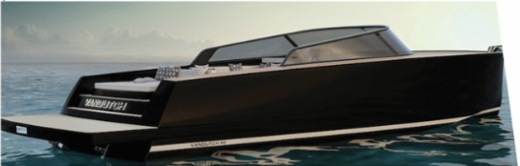
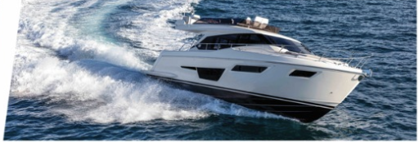
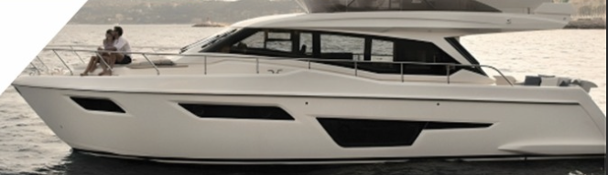
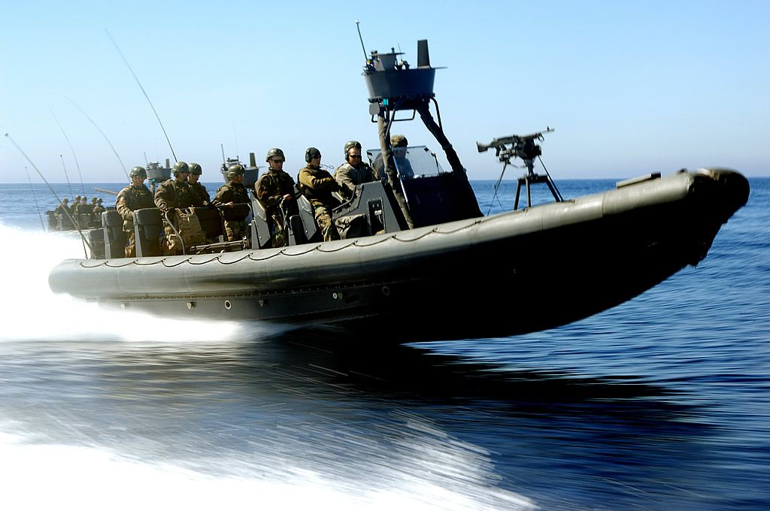
ADVANCED COMPOSITES CONSTRUCTIONS — The Ideal Partner for Naval Forces
Why Choose ACC SRL?
60%
70%
ACC SRL delivers more than boats—we provide complete, reliable, efficient solutions tailored to the specific needs of modern naval forces. Composites are not merely an alternative; they represent the future of military shipbuilding.
Weight Reduction
Less Maintenance
Our combined experience, cutting-edge technology, and commitment to excellence position us as the ideal partner for modernizing and expanding any navy’s capabilities.
Compared to metal constructions
Reduced operating cost
Complimentary Technical Consulting
Demonstrations and Trials
Lifetime Support
Our team of experts is ready to discuss your specific requirements and propose optimal solutions aligned with your budget and project timeline.
We offer the opportunity to test our vessels in real operating conditions to validate performance and support informed procurement decisions.
Comprehensive maintenance, operator training, spare parts, and technology upgrades maximize the long-term return on investment.
"Together, we can build a naval future that is safer, more capable, and more efficient. Investing in today’s composite technology delivers tomorrow’s naval supremacy."
Contact us today to discuss your project and discover how ACC SRL solutions can transform naval capabilities. Visit yachtconstructions.com.
ADVANCED COMPOSITES CONSTRUCTIONS SRL — Building naval excellence through composite innovation.

